Slide 1
Notes:
Change the graphic “Family Care” to your customer/prospect or other party. If N/A, delete and Center the CaptureRx logo

Slide 2
Enabling Missions with 340B Solutions
Over 20 years of 340B leadership
Over 8 million lives served
Over 550 CEs and 3,500 pharmacies
Over 19 million eligible prescriptions
Over $2.5 billion in savings for CEs

Slide 3
Three Pillars to Enable Your Mission
Deliver
optimal
340B
savings
Deliver
dependable
340B
compliance
Impact
lives
in your
community
5 solutions
9 solutions
We’re here to serve

Slide 4
(Hero Image for Product)
The card that extends lower-cost prescriptions to your patients in need.
The card that extends lower-cost prescriptions to your patients in need.

Slide 5
Reduce Costly Drug Prices
Customize fees and/or medications to meet your organizational needs
No cost or risk to get started
Easy to implement – launch your program in about two weeks

Slide 6
340B Savings Go To Your Patients
Pass discounts from medications directly to the patient
Meets HRSA sliding fee guidelines
Enhanced 340B compliance at the point of sale

Slide 7
How CaptureCard Works
A welcome kit will be sent including your CaptureCards, flyers with pharmacies in your area, as well as criteria for eligible patients
Cards are distributed to entities for free at initial sign up
Entities determine which patients qualify for CaptureCard at the point of sale

Slide 8
How CaptureCard Works
Patients present their CaptureCard to a qualified pharmacy to receive discounts
Pharmacies maintain their current point-of-sale procedures
Discount fees and medications eligible for the program can be customized for the entity
Ask about our one-time-use card option – it’s a perfect solution for hospitals

Slide 9
Five Good Reasons To Start Today
Lower drug costs
Reduce readmission rates
Tailor your cards to fit your needs
Demonstrate direct use of 340B funds to comply with HRSA requirements
Customize CaptureCard to Match Your Brand
© 2021 CaptureRx. All rights reserved. CONFIDENTIAL AND PROPRIETARY INFORMATION.

Slide 10
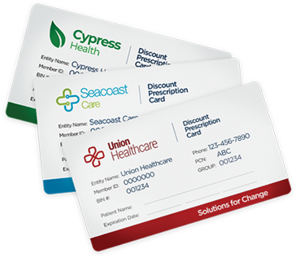

Slide 12
Our mission is to enable your mission
Delivering optimal 340B savings
Delivering dependable 340B compliance
Impacting lives in your community

